Slide 1
Person Detection for Smart City
VisionX

Slide 2

Team Members
Maruli Tyson Hamonangan Sianipar
Budi Kawira
Dana Putra Kembara
Efenus Valentino S
Mustafa

Slide 3
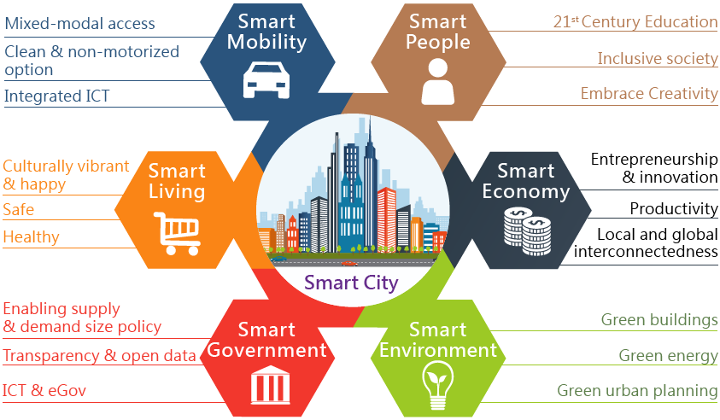
SMART CITY to SAFETY CITY

Slide 4
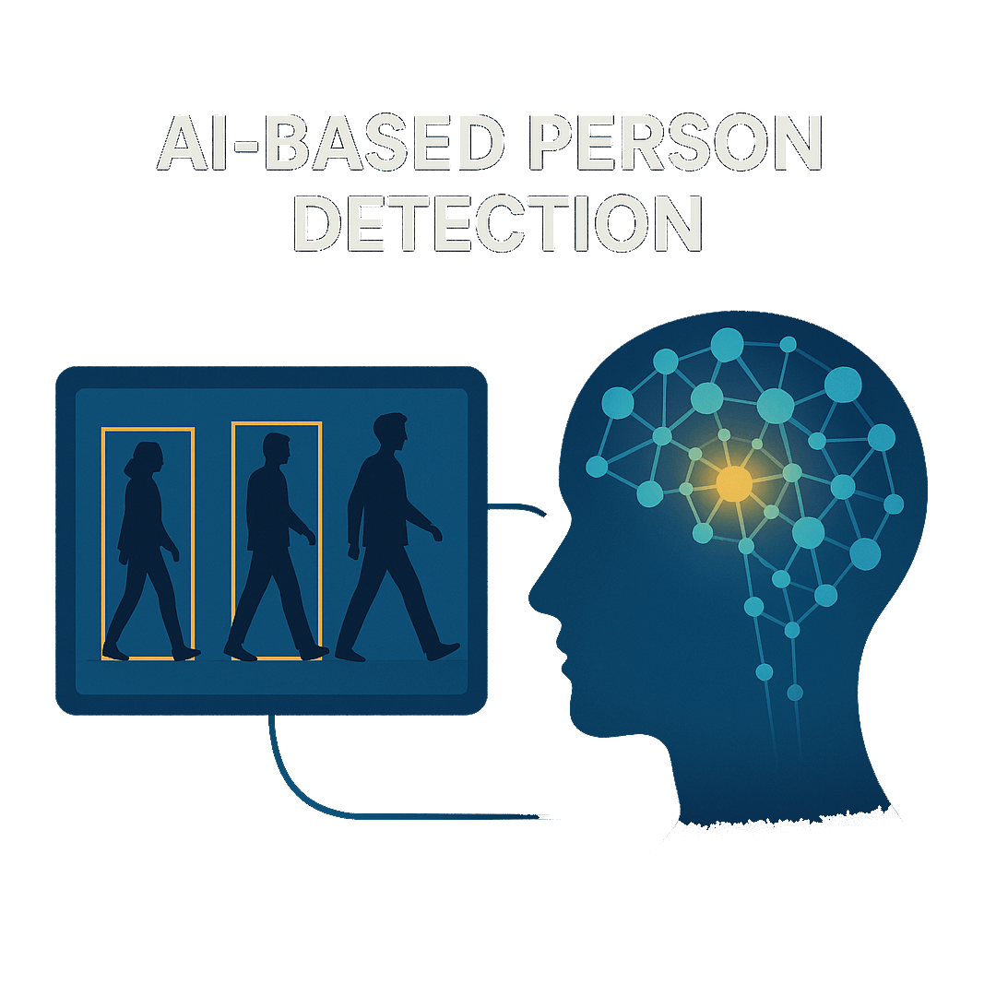
Project description
Objective : Detect and track people who are at certain points to support city security → Smart Living
Project’s importance:
Person detection is a critical task in computer vision, enabling systems to localize and identify individuals in images or video streams. Among the most influential approaches are deep learning-based object detectors such as YOLO (You Only Look Once) and R-CNN (Region-based Convolutional Neural Network
Project’s goal:
Develop a Robust Person Detection Pipeline
Analyze Strength and Weakness of each architecture

Slide 5
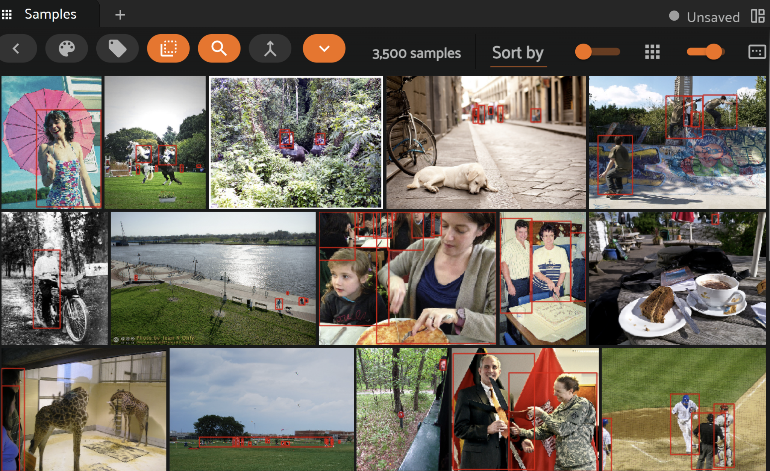
Dataset
Dataset | Labels | Label Types | Train Data | Validation Data
COCO-2017 | [ “person” ] | [ “detections” ] | 3000 | 500

Slide 6


Model development
Model 1
Train All Layers,
Train Parameters
Model 1
Train All Layers,
Train Parameters
Model 2
Freeze Backbone Layers,
Train Parameters
RCNN
YOLO11n

Slide 7
Training protocol YOLO11
Hyperparameters used:
Parameter | Model 1 | Model 2
epochs | 50 | 50
imgsz | 640 | 640
optimizer | AdamW | AdamW
lr0 | 0.001 | 0.0001
lrf | 0.01 | 0.01
momentum | 0.9 | 0.9

Slide 8
Training protocol YOLO11
Hyperparameters used:
Parameter | Model 1 | Model 2
weight_decay | 0.0005 | 0.0005
warmup_epochs | 3 | 3
warmup_momentum | 0.8 | 0.8
warmup_bias_lr | 0.1 | 0.1
cos_lr | True | True
Freeze Layers | N/A | Backbone (Layer 0 - 10)

Slide 9
Training protocol RCNN
Hyperparameters used:
Parameter | Model 1 | Model 2

Slide 10
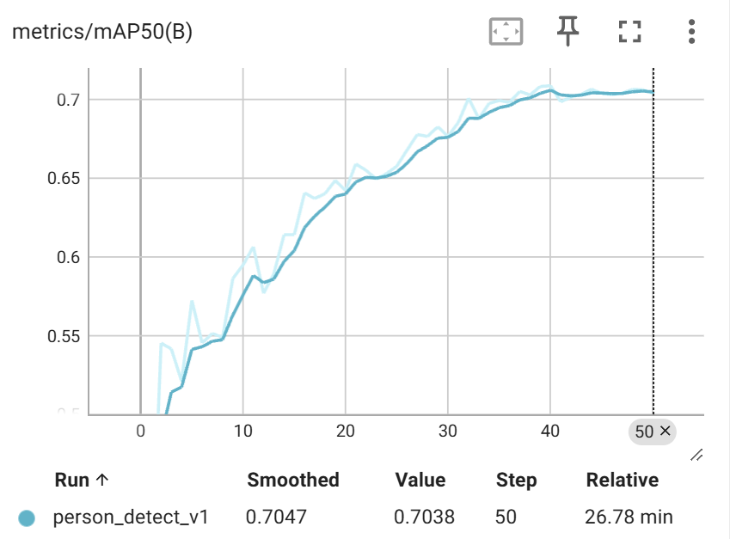
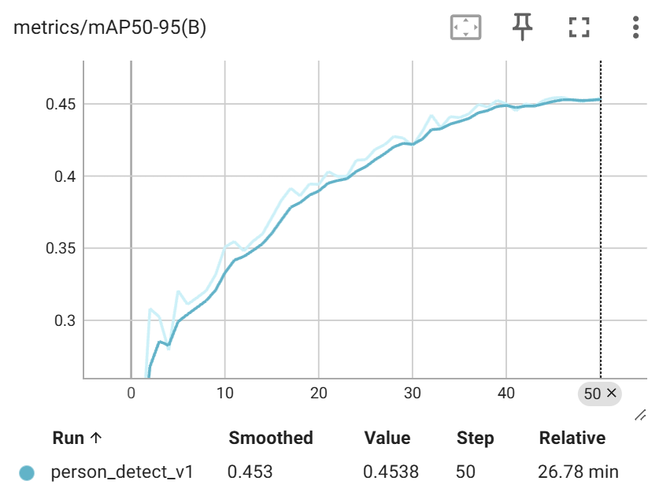
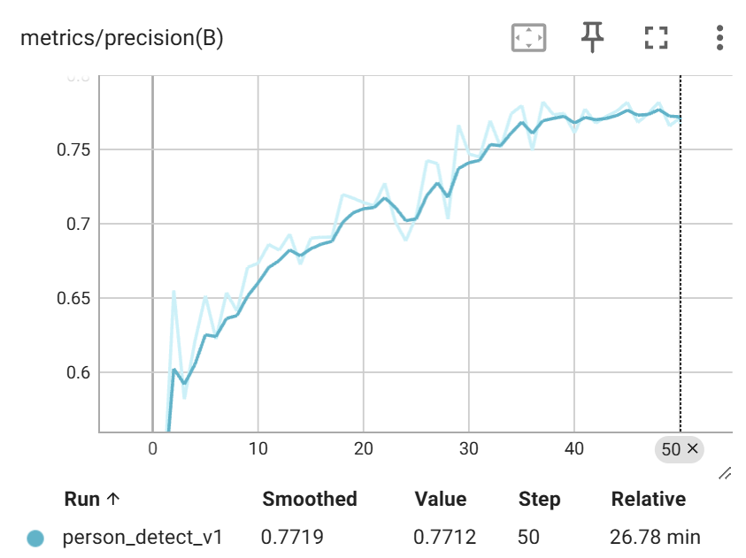
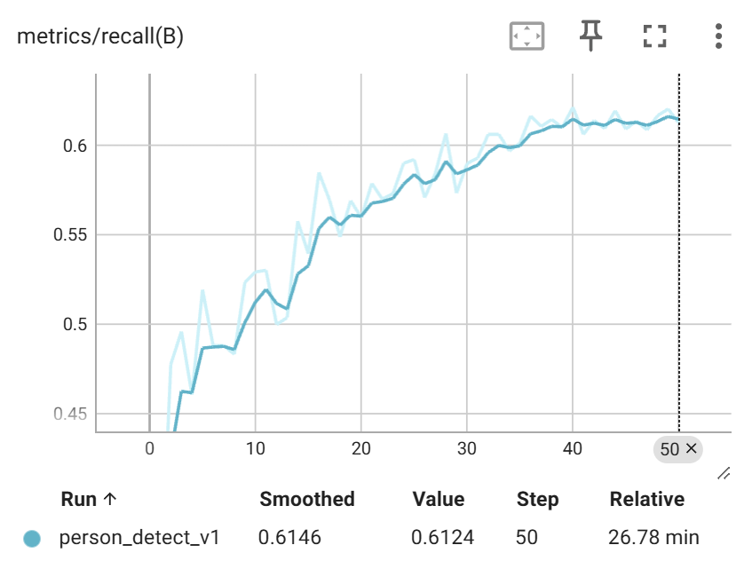
Evaluation metrics YOLO11 Model 1

Slide 11
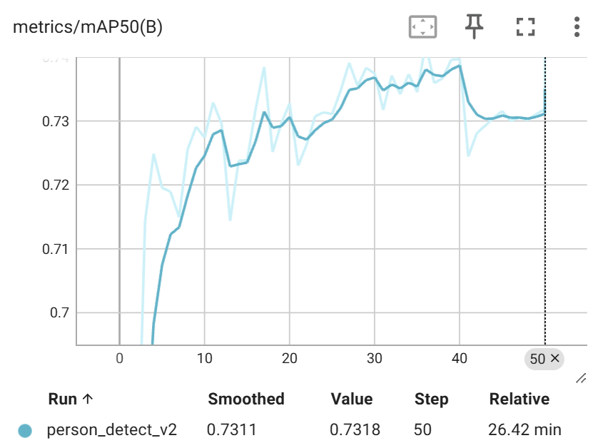
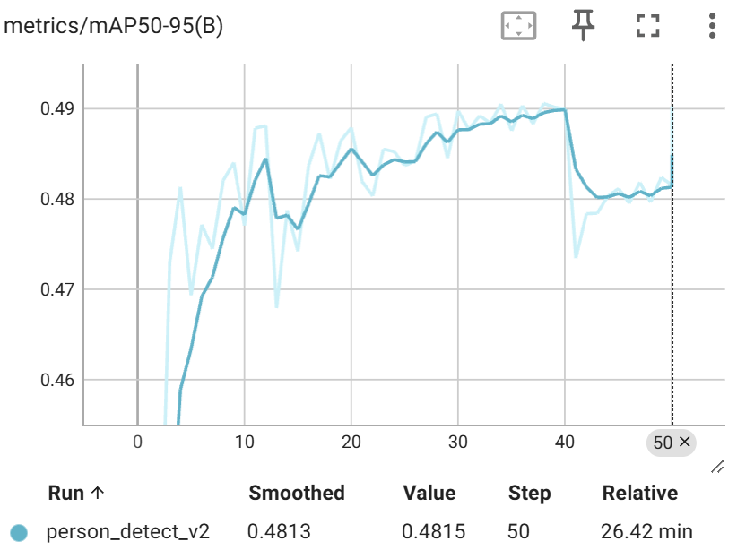
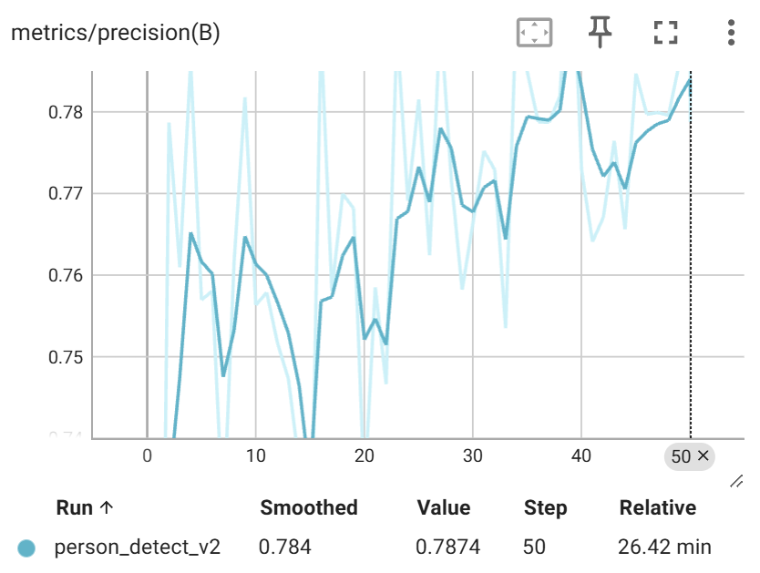
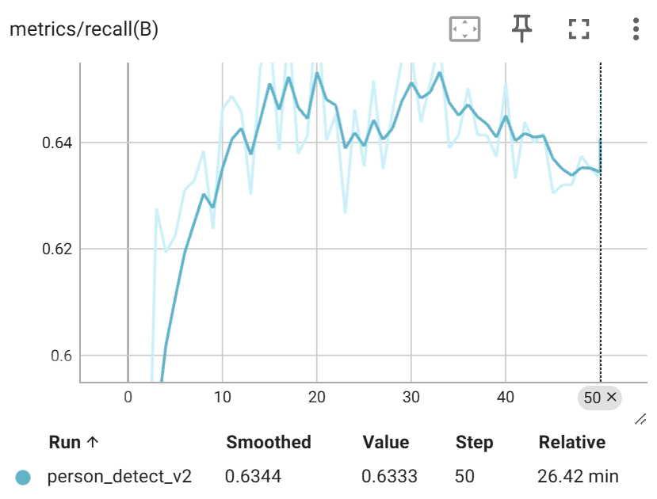
Evaluation metrics YOLO11 Model 2

Slide 12
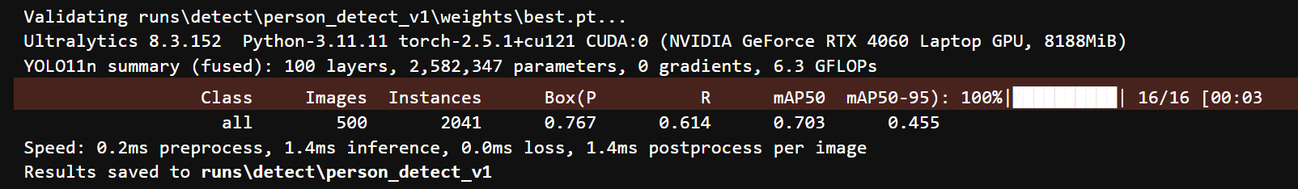
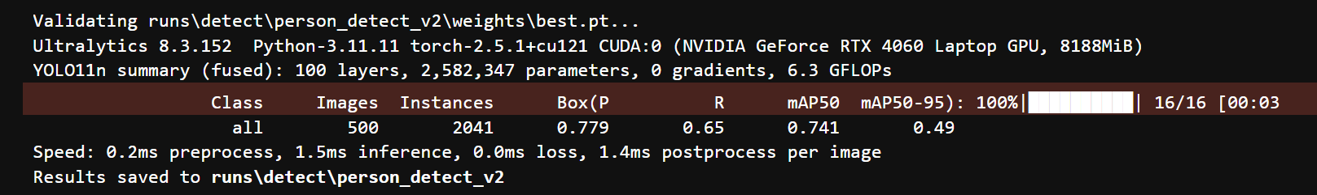
Validation
Model 1
Model 2

Slide 13
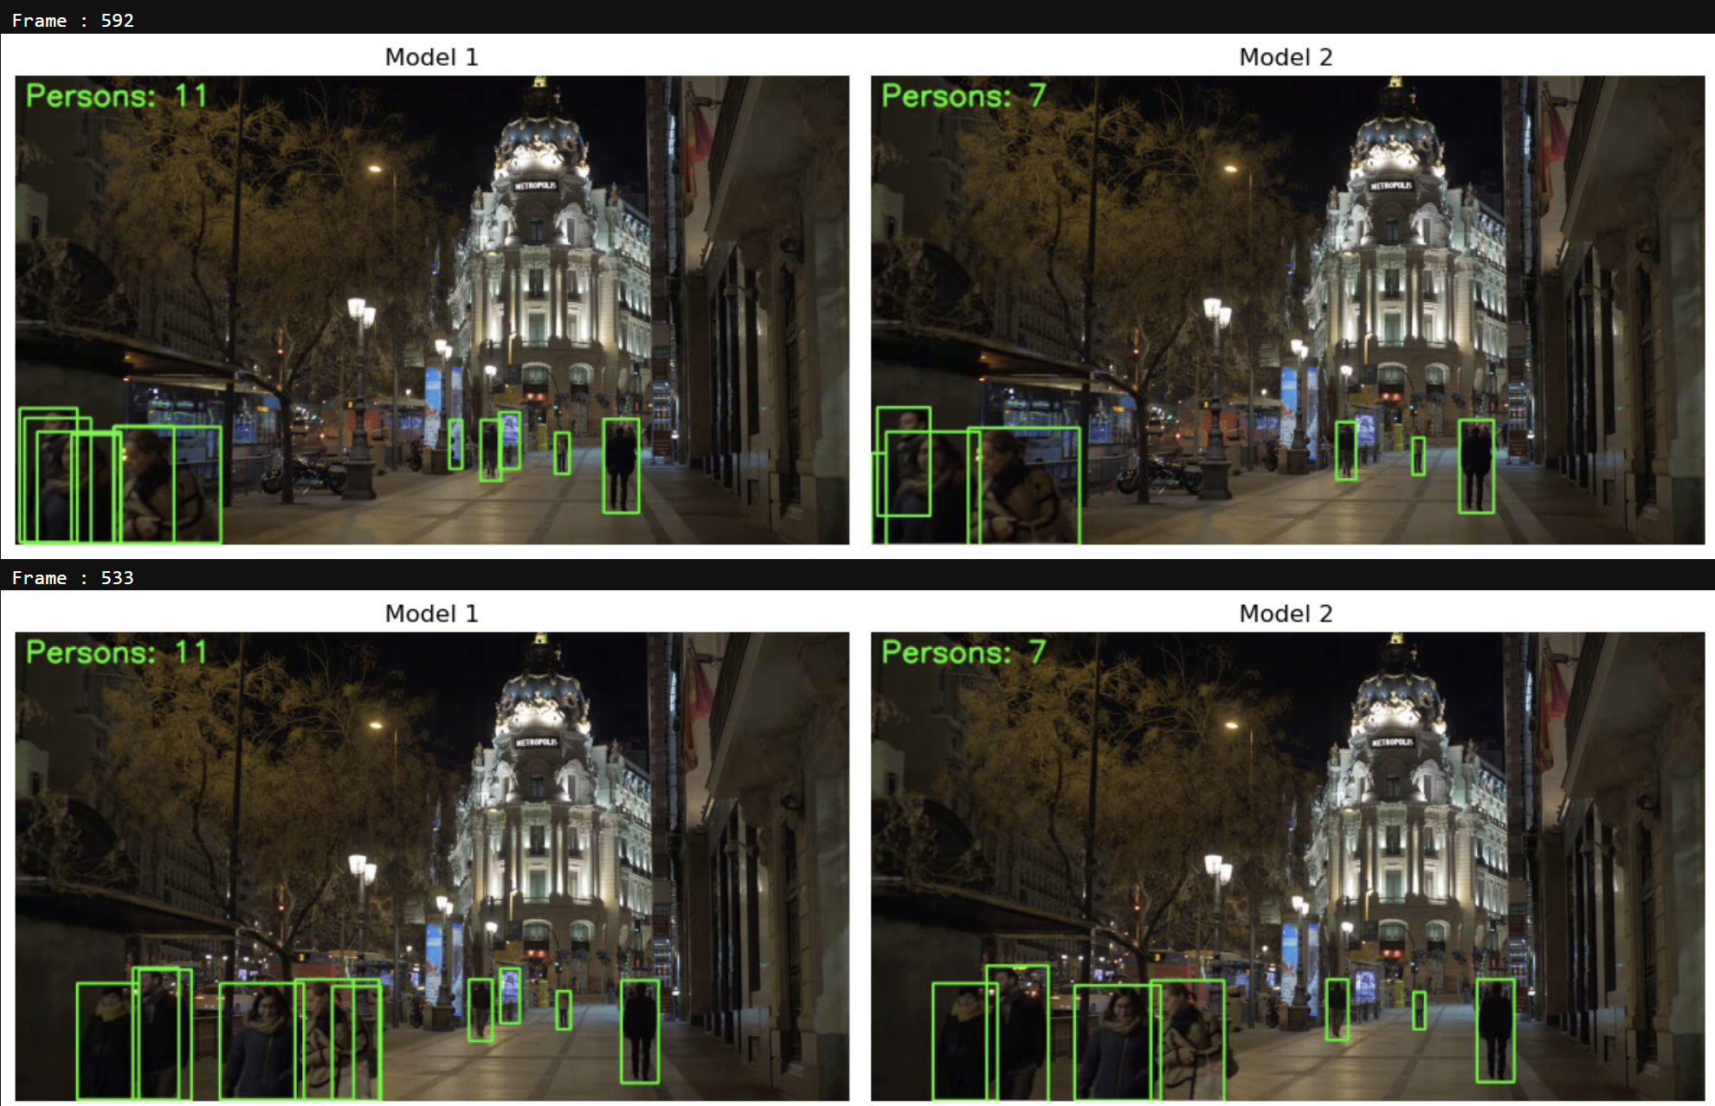
Inference YOLO11

Slide 14
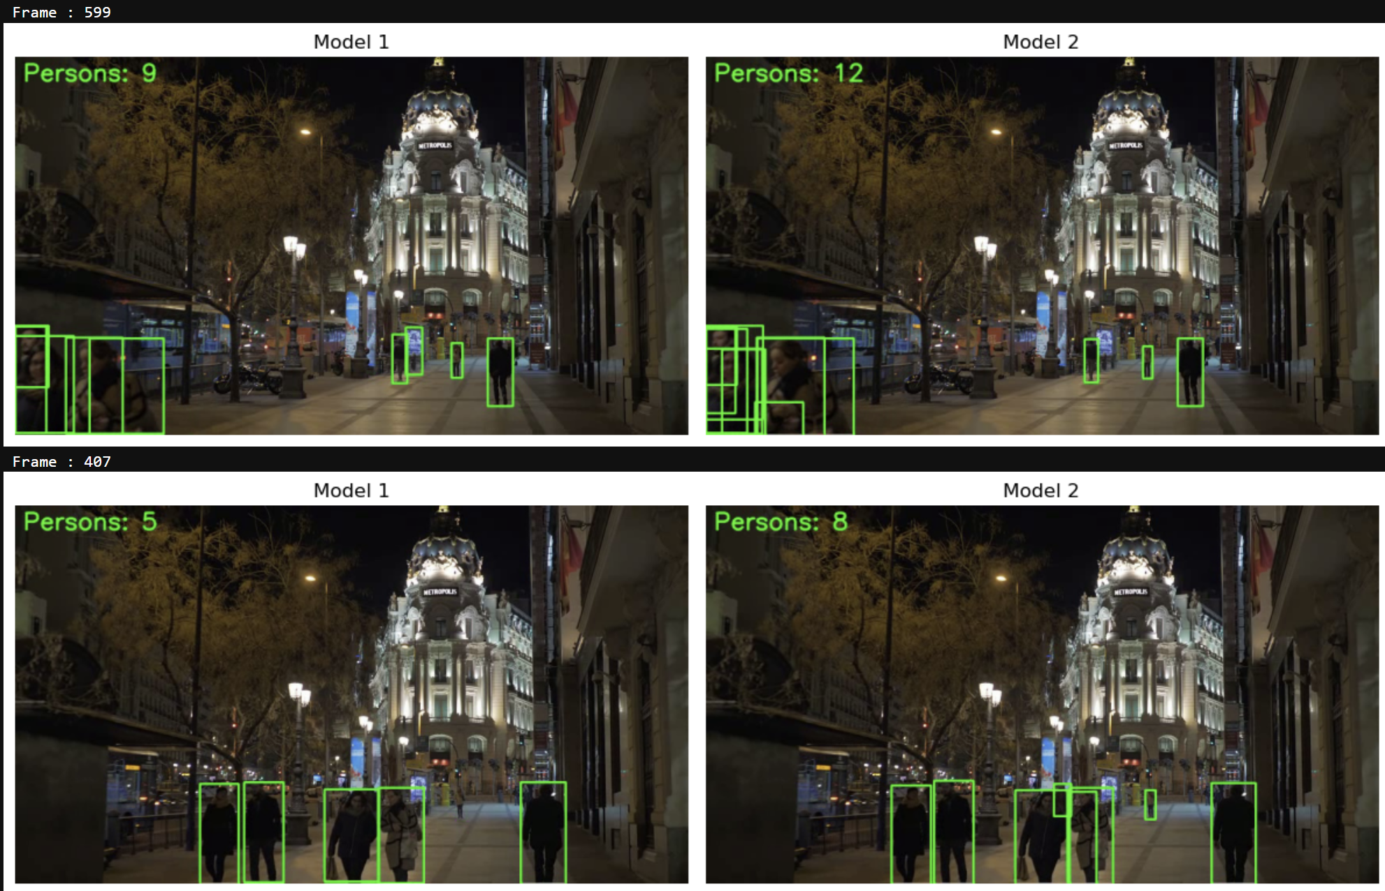
Inference YOLO11

Slide 15
Inference YOLO11
Source video: street.mp4
Output video YOLO11 Model 1: output1.mp4
Output video YOLO11 Model 2: output2.mp3

Slide 16
Conclusion & Future improvement
Conclusion:
YOLO11 is able to perform person detection with good accuracy and minimum inference time
Hyperparameter tuning is able to increase model accuracy
YOLO11 Person detection implementation can be for monitoring video in real time since the inference time is small
Different hyperparameter configuration will result a different output
Future Improvement
More experiment on the hyperparameter tuning to get optimal result
Experiment on different dataset to compare the output result
Experiment on different architecture to compare the accuracy and inference time.

Slide 17
Komentar
Pembagian tugasnya lebih detail
Dataset : sudah dijelaskan jumlahnya
Gambar plot evaluation matrix diperbesar
Set IOU saat Inference agar hanya object dengan confidence level tertentu yang terdeteksi
Display confidence level di bounding box

